Slide 1
Information Security
By
Mrs. Kinyirira N. Bartha Alexandra

Slide 2
Chapter two topics
Controlling Access
Access Control Attacks
Testing Access Controls

Slide 3
Controlling Access
Identification and Authentication
Identification: unproven declaration of identity
“My name is…”
      Userid
Authentication: proven declaration of identity
    Userid and password
    Userid and PIN
    Biometric

Slide 4
Controlling Access
Authentication Methods
What the user knows
    Userid and password
    Userid and PIN
What the user has
    Smart card
    Token
What the user is
    Biometrics (fingerprint, handwriting, voice, etc.)

Slide 5
Controlling Access
How Information Systems Authenticate Users
Request userid and password
    Hash / jumble password
    Retrieve stored userid and hashed password
    Compare
    Make a function call to a network based authentication service
How a User Should Treat Userids and Passwords
  Keep it a secret
  Do not share with others
  Do not leave it written down where someone else can find it
  Store in an encrypted file

Slide 6
Controlling Access
How a System Stores Userids and Passwords
Typically stored in a database table
  Application database or authentication database
  Userid stored in plaintext
    Facilitates lookups by others
    Password stored encrypted or hashed
    If encrypted, can be retrieved under certain conditions
      “Forgot password” function, application emails to user
    If hashed, cannot be retrieved under any circumstance (best method)

Slide 7
Controlling Access
1. Strong Authentication
Traditional userid + password authentication has known weaknesses
  Easily guessed passwords
  Disclosed or shared passwords
Stronger types of authentication available, usually referred to as “strong authentication”
  Token
  Certificate
  Biometrics

Slide 8
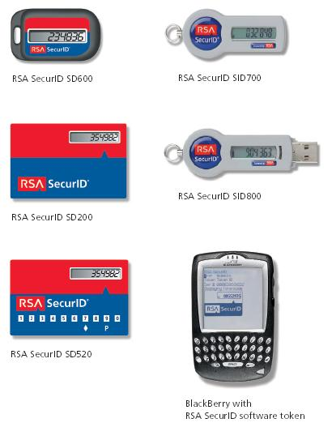
Controlling Access
2. Two Factor Authentication
First factor: what user knows
Second factor: what user has
  Password token
  USB key
  Digital certificate
  Smart card
Without the second factor, user cannot log in
  Defeats password guessing / cracking

Slide 9
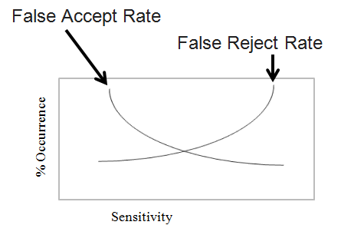
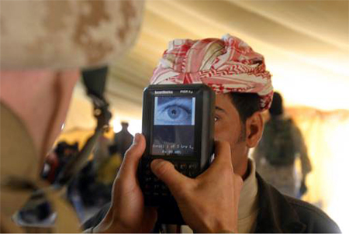
Controlling Access
3.Biometric Authentication
Stronger than userid + password
Stronger than two-factor?
  Can be hacked
Measures a part of user’s body
  Fingerprint
  Iris scan
  Signature
  Voice

Slide 10
Controlling Access
Authentication Issues
Password quality
Consistency of user credentials across multiple environments
Too many userids and passwords
Handling password resets
Dealing with compromised passwords
Staff terminations

Slide 11
Controlling Access
Access Control Technologies
Centralized management of access controls
  LDAP
    Active Directory, Microsoft's LDAP
  RADIUS
    Diameter, upgrade of RADIUS
  TACACS
    Replaced by TACACS+ and RADIUS
  Kerberos
  Uses Tickets
Write short notes about the above access control technologies

Slide 12
Controlling access
Single Sign-On (SSO)
Authenticate once, access many information systems without having to re-authenticate into each
Centralized session management
Often the “holy grail” for identity management
Harder in practice to achieve – integration issues
Reduced Sign-On
Like single sign-on (SSO), single credential for many systems
But… no inter-system session management
User must log into each system separately, but they all use the same userid and password
Weakness of SSO and RSO
Weakness: intruder can access all systems if password is compromised
Best to combine with two-factor / strong authentication
Write short notes about SSO and RSO include their benefits and criticisms

Slide 13
Access Control Attacks
Introduction
Intruders will try to defeat, bypass, or trick access controls in order to reach their target
Attack objectives
  Guess credentials / id
  Malfunction of access controls
  Bypass access controls
  Replay known good logins
  Trick people into giving up credentials

Slide 14
Access Control Attacks…
1. Buffer Overflow
Cause malfunction in a way that permits illegal access
Send more data than application was designed to handle properly
  “Excess” data corrupts application memory
  Execution of arbitrary / illogical code
  Malfunction
Countermeasure: “safe” coding that limits length of input data; filter input data to remove unsafe characters

Slide 15
Access Control Attacks
2. Script Injection
Insertion of scripting language characters into application input fields
  Execute script on server side
    SQL injection – obtain data from application database
  Execute script on client side – trick user or browser
    Cross site scripting
    Cross site request forgery
Countermeasures: strip / narrow “unsafe” characters from input

Slide 16
Access Control Attacks
3. Data Remanence
Literally: data that remains after it has been “deleted”
Examples
  Deleted hard drive files
  Data in file system “slack space”
  Erased files
  Reformatted hard drive
  Discarded / lost media: USB keys, backup tapes, CDs
Countermeasures: improve media physical controls

Slide 17
Access Control Attacks
4. Denial of Service (DoS)
Actions that cause target system to fail, thereby denying service to legitimate users
  Specially crafted input that causes application malfunction
  Large volume of input that floods application
  Distributed Denial of Service (DDoS)
  Large volume of input from many (hundreds, thousands) of sources
Countermeasures: input filters, patches, high capacity

Slide 18
Access Control Attacks
5. Dumpster Diving
Literally, going through company trash in the hopes that sensitive printed documents were discarded that can be retrieved
  Personnel reports, financial records
  E-mail addresses
  Trade secrets
  Technical architecture
Countermeasures: on-site shredding
secure paper shredding and confidential waste disposal

Slide 19
Access Control Attacks
6. Eavesdropping
Interception of data transmissions
  Login credentials
  Sensitive information
Methods
  Network sniffing (maybe from a compromised system)
  Wireless network sniffing
Countermeasures: encryption, stronger encryption

Slide 20
Access Control Attacks
7. Emanations
Electromagnetic radiation that emanates / originates from computer equipment
  Network cabling
    More prevalent in networks with coaxial cabling
  CRT monitors
  Wi-Fi networks
Countermeasures: shielding, twisted pair network cable, LCD monitors, lower power or eliminate Wi-Fi

Slide 21
Access Control Attacks
8. Spoofing and Masquerading
Specially crafted network packets that contain forged address of origin
TCP/IP protocol permits forged MAC and IP address
TCP/IP provides end-to-end connectivity specifying how data should be formatted, addressed, transmitted, routed and received at the destination
A media access control address (MAC address) is a unique identifier assigned to network interfaces for communications on the physical network segment.
SMTP protocol permits forged e-mail “From” address
Countermeasures: router / firewall configuration to drop forged packets, judicious use of e-mail for signaling or data transfer

Slide 22
Access Control Attacks
9. Social Engineering
Tricking people into giving out sensitive information by making them think they are helping someone
Methods
  In person
  By phone
  Schemes
  Log-in, remote access, building entrance help
Countermeasures: security awareness training

Slide 23
Access Control Attacks
10. Phishing
Incoming, fraudulent / false e-mail messages designed to give the appearance of origin from a legitimate institution
  “Bank security breach”
  “Tax refund”
Tricks user into providing sensitive data via a forged web site (common) or return e-mail (less common)
Countermeasure: security awareness training

Slide 24
Access Control Attacks
11. Pharming
Redirection of traffic to a forged website
  Attack of DNS (Domain name system) server (poison cache, other attacks)
  Domain Name System, internet system used to translate names into IP addresses
  Attack of “hosts” file on client system
  Often, a phishing e-mail to entice user to forged website
  Forged website has appearance of the real thing
Countermeasures: user awareness training, patches, better controls

Slide 25
Access Control Attacks
12. Password Guessing
Trying likely passwords to log in as a specific user
  Common words
  Spouse / partner / pet name
  Significant dates / places
Countermeasures: strong, complex passwords, aggressive password policy, lockout policy

Slide 26
Access Control Attacks
13. Password Cracking
Obtain / retrieve hashed passwords from target
Run password cracking program
  Runs on attacker’s system – no one will notice
Attacker logs in to target system using cracked passwords
Countermeasures: frequent password changes, controls on hashed password files.

Slide 27
Access Control Attacks
15. Malicious Code
Viruses, worms, Trojan horses, spyware, key logger
Harvest data or cause system malfunction
Countermeasures: anti-virus, anti-spyware, security awareness training

Slide 28
Access Control Concepts
Topics to be covered;
Principles of access control
Types of controls
Categories of controls

Slide 29
Principles of Access Control
1. Separation of duties
  No single individual should be allowed to perform high-value or sensitive tasks on their own
    Financial transactions
    Software changes
    User account creation / changes

Slide 30
Principles of Access Control
2. Least privilege
  Persons should have access to only the functions / data that they require to perform their stated duties
  Server applications
    Don't run as root
  User permissions on File Servers
    Don't give access to others' files
  Workstations
    User Account Control

Slide 31
Principles of Access Controls (cont.)
3. Defense in depth
  Use of multiple controls to protect an asset
  Heterogeneous controls preferred
  If one type fails, the other remains
  If one type is attacked, the other remains
Examples
  Nested firewalls
  Anti-virus on workstations, file servers, e-mail servers

Slide 32
Types of Controls
1. Technical
  Authentication, encryption, firewalls, anti-virus
2. Physical
  Key card entry, fencing, video surveillance
3. Administrative
  Policy, procedures, standards

Slide 33
Categories of Controls
Detective controls
Deterrent controls
Preventive controls
Corrective controls
Recovery controls
Compensating controls

Slide 34
Categories of Controls…
1. Detective Controls
Monitor and record specific types of events
Does not stop or directly influence events
  Video surveillance
  Audit logs
  Event logs
  Intrusion detection system

Slide 35
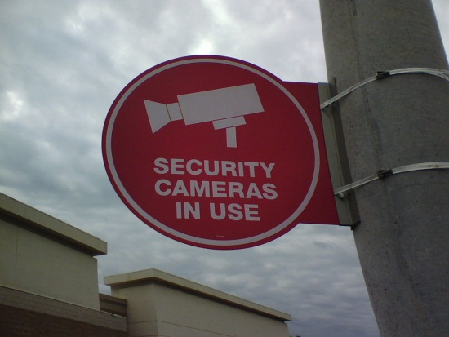
Categories of Controls…
2. Deterrent Controls
Highly visible
Prevent offenses by influencing
choices of would-be intruders
A purely deterrent control does not prevent or even record events
  Signs
  Guards, guard dogs (may be preventive if they are real)
  Razor wire

Slide 36
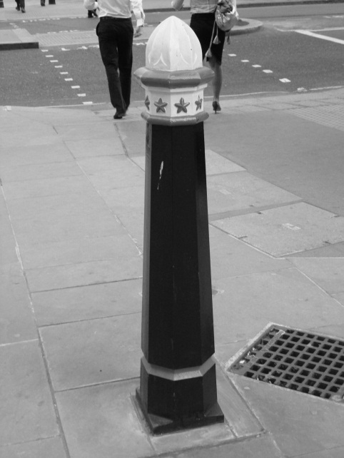
Categories of Controls
4. Preventive Controls
Block or control specific events
  Firewalls
  Anti-virus software
  Encryption
  Key card systems
  Bollards stop cars (as shown

Slide 37
Categories of Controls
5. Corrective Controls
Post-event controls to prevent recurrence
“Corrective” refers to when it is implemented
  Can be preventive, detective, deterrent, administrative
Examples (if implemented after an incident)
  Spam filter
  Anti-virus on e-mail server
  WPA Wi-Fi encryption

Slide 38
Categories of Controls
6. Recovery Controls
Post-incident controls to recover systems
Examples
  System restoration
  Database restoration

Slide 39
Categories of Controls…
7. Compensating Controls
Control that is introduced that compensates for the absence or failure of a control
“Compensating” refers to why it is implemented
  Can be detective, preventive, deterrent, administrative
Examples
  Daily monitoring of anti-virus console
  Monthly review of administrative logins
  Web Application Firewall used to protect buggy application

Slide 40
Testing Access Controls
Testing Access Controls
Access controls are the primary defense that protect assets
Testing helps to verify whether they are working properly
Types of tests
  Penetration tests
  Application vulnerability tests
  Code reviews

Slide 41
Types of tests …
1. Penetration Testing
Automatic scans to discover vulnerabilities
  Scan TCP/IP for open ports, discover active “listeners”
  Potential vulnerabilities in open services
  Test operating system, middleware, server, network device features
  Missing patches
Example tools: Nessus, Nikto, SAINT, Superscan, Retina, ISS, Microsoft Baseline Security Analyzer

Slide 42
Types of tests ….
2. Application Vulnerability Testing
Discover vulnerabilities in an application
Automated tools and manual tools
Example vulnerabilities
  Cross-site scripting, injection flaws, malicious file execution, broken authentication, broken session management, information leakage, insecure use of encryption, and many more

Slide 43
Types of tests …..
3. Audit Log Analysis
Regular examination of audit and event logs
Detect unwanted events
  Attempted break-ins
  System malfunctions
  Account abuse, such as credential sharing
Audit log protection
  Write-once media
  Centralized audit logs

